Slide 1

WIP – Birthday Paradox
Mentor – Sarthak Saxena
Project by – yashasvi Jain, Vivek Kumar

Slide 2

Let’s know about R Language briefly.
The R Language is a project developed at Bell Laboratories and available for free under the GNU license. As a collection of software tools that work together, the R language is a software environment that accommodates a full user experience, from computational results from individual algorithms and code functions to interface technologies for display.

Slide 3
What is a Birthday Paradox Problem?
The probability of birthday of a pair reaches 99.9% when taken in account the data of random 75 people is termed as Birthday Paradox or Birthday Problem. However, the probability reaches 100% when 367 people are taken in account. As we only have 365 days in year, except leap years. Exception: Excluding the year which has Feb 29 as well.

Slide 4
For instance
Among 44 American Presidents;
Warren Harding
And James Polk
have same birth-date; 2nd Nov.

Slide 5
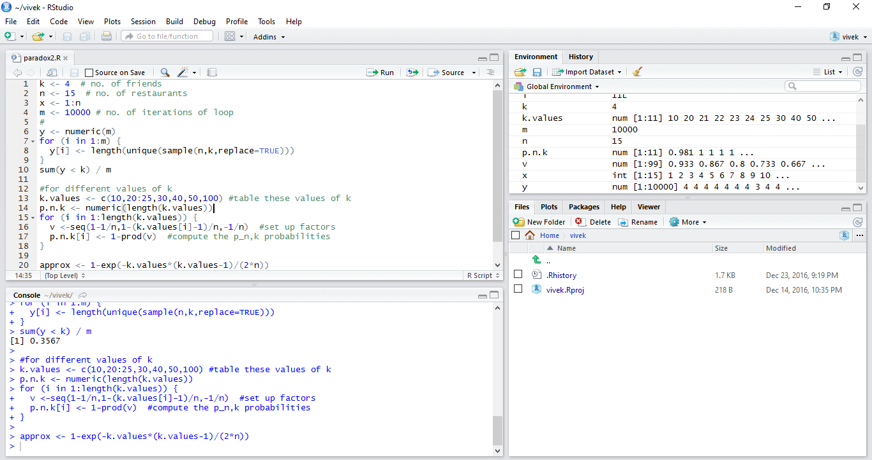
Sample Birthday Paradox Code[Type-1] :

Slide 6
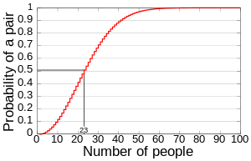
The Resulting Graph!

Slide 7
Code(Type-II)
The next Code has used
Standard Birth Probability
Data from Internet.
(dayprobs).

Slide 8
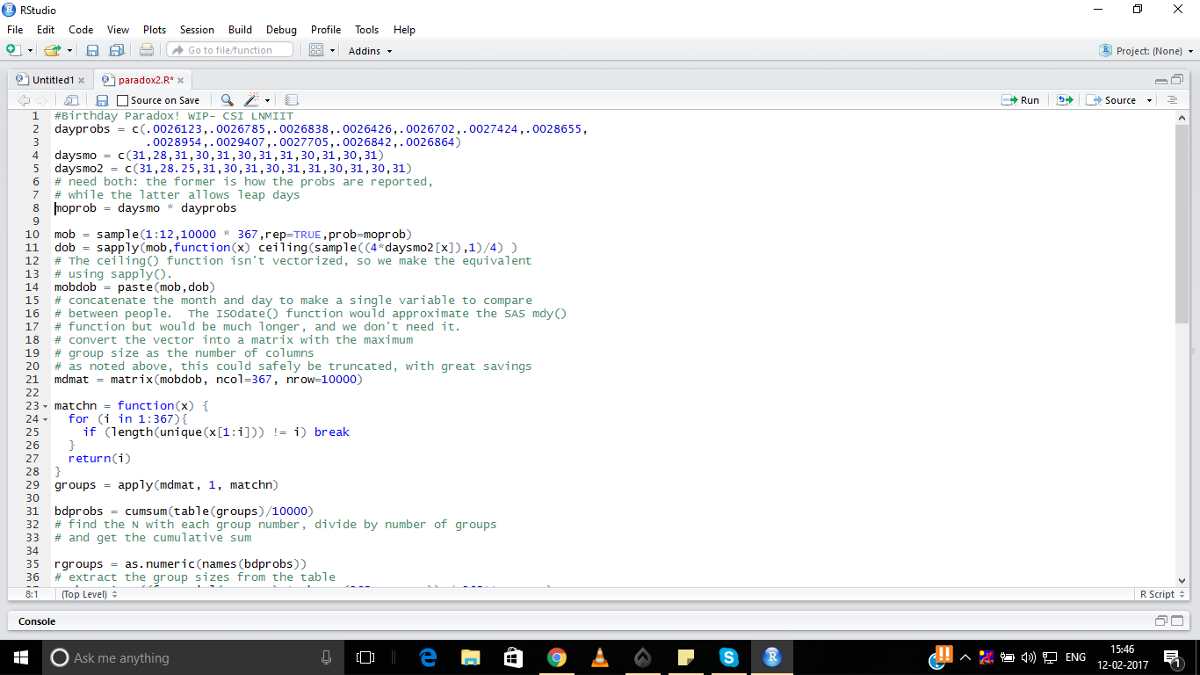
The Testing Code:
Main
Code

Slide 9
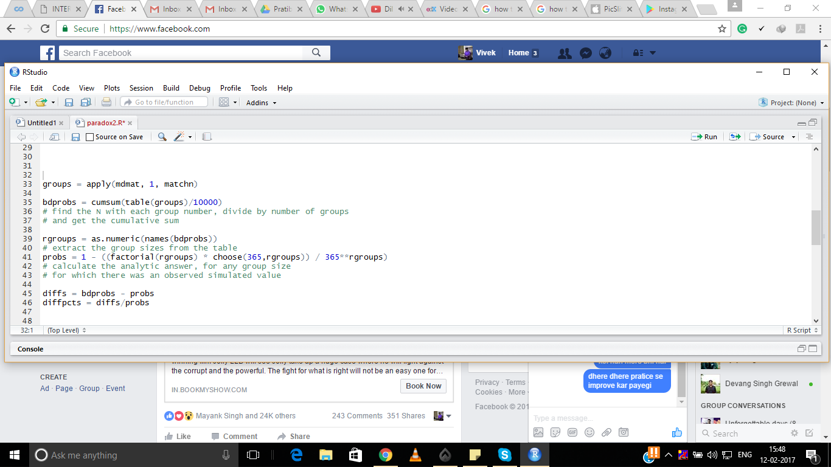
The Testing Code:
[Building of Groups]

Slide 10
After Grouping the values from output,
We are plotting them.
Xname = Number in groups
Y1name = Diff. in Prob.
Y2name = Diff. in Percentage.

Slide 11
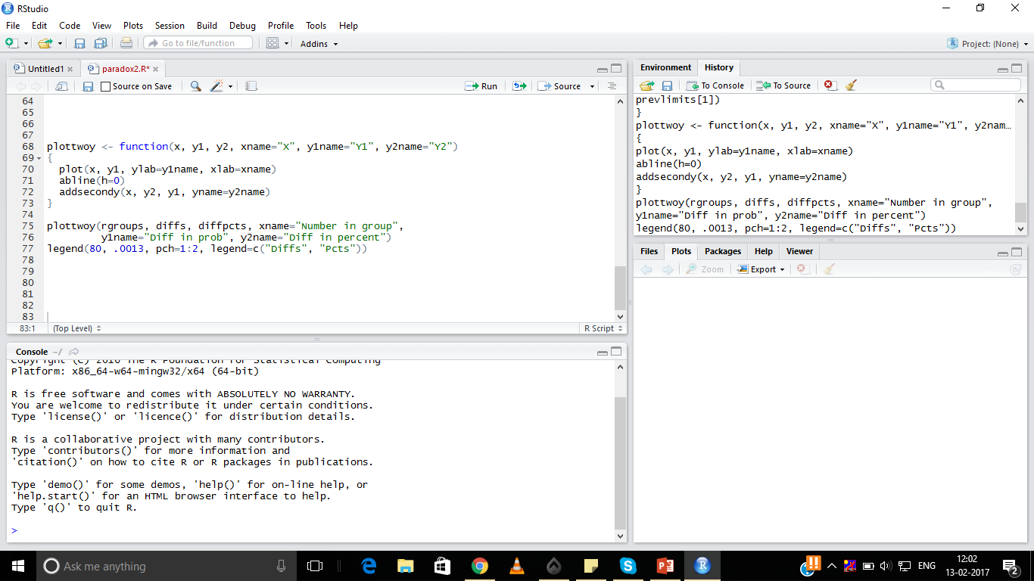
The Testing Code:
Plotting the Result

Slide 12
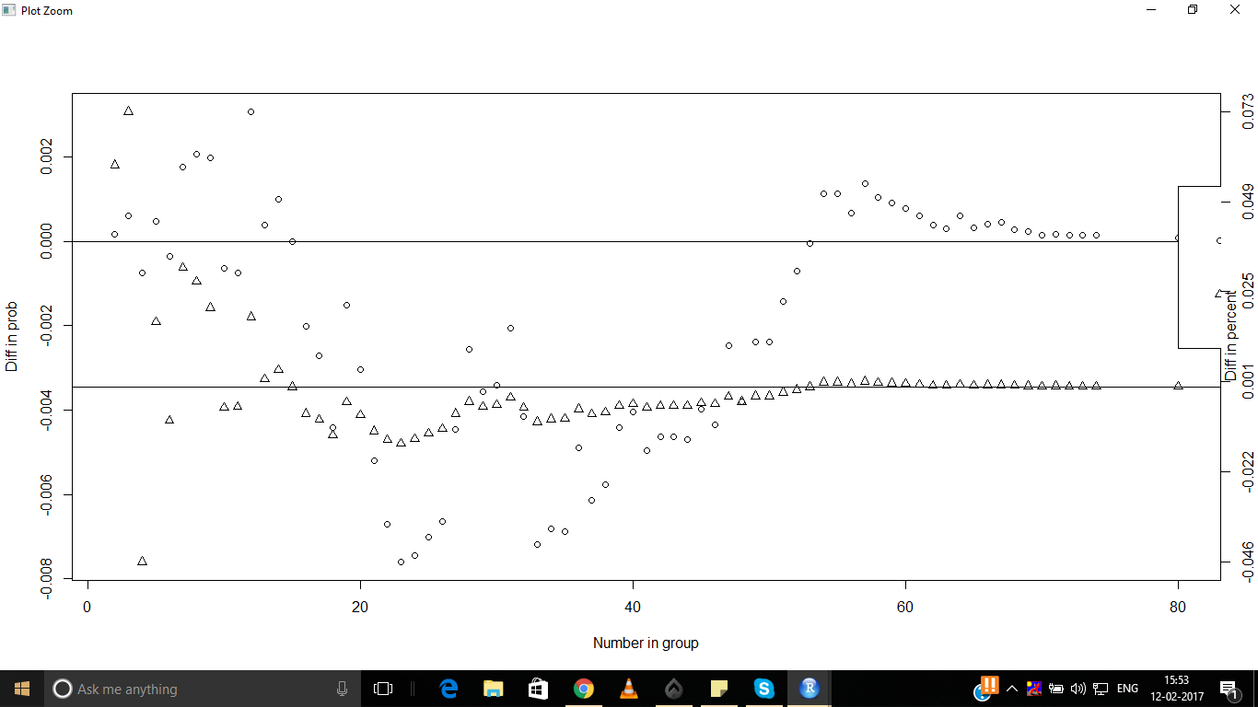
The Final Graph!

Slide 13

The_End;

